Slide 1
SQL Server
Creating and Altering Tables
In all slides, db=database

Slide 2
Object Names
Before we start creating tables, we should understand some object conventions.
SQL Server looks at only a very narrow scope when trying to identify and locate the objects you name in your queries and other statements.
We’ve only been providing the names of tables without any additional information, but there are actually four levels in the naming convention for any SQL Server table (and any other SQL Server object for that matter).

Slide 3
Fully Qualified Domain Name
A fully qualified name looks like:
    [ServerName.[DatabaseName.[SchemaName.]]]ObjectName
You must provide an object name whenever you are performing an operation on that object, but all parts of the name to the left of the object name are optional.
Most of the time, they are not needed, and are therefore left off.

Slide 4
Schema
Database schema - distinct namespace
It is a “container of objects”
Schema objects include tables, views, sequences, and indexes.

Slide 5
Schema (continued)
In previous versions of SQL Server, database users and schemas were conceptually the same object. Beginning in SQL Server 2005, users and schemas are separate, and schemas serve as containers of objects.

Slide 6
The Default Schema: dbo
Whoever creates the database is considered to be the “database owner,” or dbo.
Members of sysadmin role always alias to dbo
Any objects that they create within that database shall be listed with a schema of dbo rather than their individual username.

Slide 7
Schema cont.
By default, only users who are members of the sysadmin system role, or the db_owner or db_ddladmin database roles can create objects in a database.
Individual users can also be given the right to create certain types of both database and system objects. If such individuals do indeed create an object, then, by default, that object will be assigned to whatever schema is listed as default for that login.

Slide 8
The Database Name
Sometimes you want to retrieve data from a database other than the default, or current, database.
You may actually want to JOIN data from across databases.
A database-qualified name gives you that ability.
If you were logged in with AdventureWorks as your current database, and you wanted to refer to the Orders table in the Northwind database, then you could refer to it by ‘Northwind.dbo.Orders’.

Slide 9
Naming by Server
In addition to naming other databases on the server you’re connected to, you can also “link” to another server.
Linked servers give you the capability to perform a JOIN across multiple servers—even different types of servers (SQL Server, Oracle - anything with an OLE DB provider).

Slide 10
The Naming Hierarchy
(left to right)
Object Name: There isn’t a default—you must supply an object name.
Schema (aka Ownership): You can leave this off, in which case it will resolve first using the current user’s name, and then, if the object name in question doesn’t exist with the current user as owner, then it will try the dbo as the owner.
Database Name: This can also be left off unless you are providing a Server Name—in which case you must provide the Database Name for SQL Servers (other server types vary depending on the specific kind of server).
Server Name: You can provide the name of a linked server here, but most of the time you’ll just leave this off, which will cause SQL Server to default to the server you are logged into.

Slide 11
CREATE DATABASE
When you create a new object, no one can access it except for the person that created it, the system administrator, and the database owner.
You can use the CREATE statement only to create objects on the local server (adding in a specific server name doesn’t work).

Slide 12

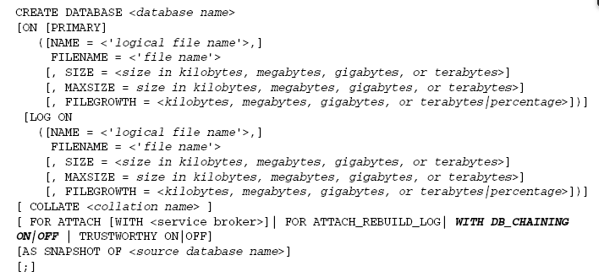
Syntax

Slide 13
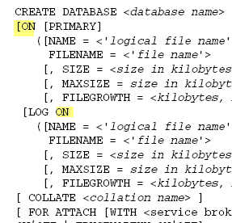
ON
ON is used in two places: to define the location of the file where the data is stored, and to define the same information for where the log is stored.

Slide 14
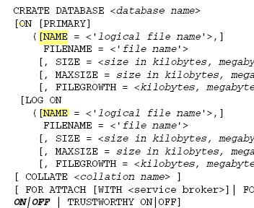
Name
The name that SQL Server will use internally to refer to that file.
You will use this name when you want to resize (expand or shrink) the database and/or file.

Slide 15
FILENAME
The physical name on the disk of the actual operating system file in which the data and log (depending on what section you’re defining) will be stored.
The data file will be named the same as your database with an .mdf extension.
The log file will be named the same as the database file but with a suffix of _Log and an .ldf extension.

Slide 16
FILENAME Size
The size of the database. By default, the size is in megabytes, but you can make it kilobytes by using a KB instead of MB after the numeric value for the size, or go bigger by using GB (gigabytes) or even TB (terabyerabytes).
This value must be at least as large as the model database is and must be a whole number (no decimals) or you will receive an error.
If you do not supply a value for SIZE, then the database will initially be the same size as the model database.

Slide 17
FILENAME MaxSize
SQLServer has a mechanism to allow your database to automatically allocate additional disk space (to grow)when necessary.
MAXSIZE is the maximum size to which the database can grow.
If your database reaches the value set in the MAXSIZE parameter, your users will start getting errors back saying that their inserts can’t be performed. If your log reaches its maximum size, you will not be able toperform any logged activity.

Slide 18
FILEGROWTH
Determines how fast it gets to the max size. You provide a value that indicates by how many bytes (in KB, MB, GB, or TB) to increment.
Alternatively, you can provide a percentage value by which you want the database file to increase. With this option, the size will go up by the stated percentage of the current database file size. Therefore, if you set a database file to start out at 1GB with a FILEGROWTH of 20 percent, then the first time it expands it will grow to 1.2GB, the second time to 1.44, and so on.

Slide 19
LOG ON
The LOG ON option allows you to establish that you want your log to go to a specific set of files and where exactly those files are to be located.
If this option is not provided, then SQL Server will create the log in a single file and default it to a size equal to 25 percent of the data file size.
It is highly recommended that you store your log files on a different drive than your main data files.
Doing so avoids the log and main data files competing for I/O off the disk as well as providing additional safety if one hard drive fails.

Slide 20
COLLATE
This one has to do with the issue of sort order, case sensitivity, and sensitivity to accents.
When you installed your SQL Server, you decided on a default collation, but you can override this at the database .level

Slide 21
FOR ATTACH
Use this option to attach an existing set of database files to the current server.

Slide 22
Building a Database
CREATE DATABASE Accounting
ON
(NAME = 'Accounting',
FILENAME = 'c:\Program Files\Microsoft SQL Server\MSSQL.1\mssql\data\AccountingData.mdf',
SIZE = 10,
MAXSIZE = 50,
FILEGROWTH = 5)
LOG ON
(NAME = 'AccountingLog',
FILENAME = 'c:\Program Files\Microsoft SQL Server\MSSQL.1\mssql\data\AccountingLog.ldf',
SIZE = 5MB,
MAXSIZE = 25MB,
FILEGROWTH = 5MB)
GO

Slide 23
This actually yields you two separate result sets. The first is based on the combined (data and log) information about your database:
The second provides specifics about the various files that make up your database—including their current size and growth settings:
EXEC sp_helpdb 'Accounting'

Slide 24
CREATE TABLE
Naming: There is more than one naming convention
Naming convention used in this book:
    For each word in the name, capitalize the first letter and use lowercase for the remaining letters.
    Keep the name short, but make it long enough to be descriptive.
    Limit the use of abbreviations.
    When building tables based on other tables (usually called linking or associate tables), you should include the names of all of the parent tables in your new table name.
    When you have two words in the name, do not use any separators (run the words together)—use the fact that you capitalize the first letter of each new word to figure out how to separate words.
With tables, we need to provide some more specifics in the form of columns, data types, and special operators.
Be
Consistent!

Slide 25
Data Types and Default
Provide a data type immediately after the column name.
Default – the value you want to be used for any rows that are inserted without a user-supplied value for this column. This is optional.

Slide 26
IDENTITY
When you make a column an identity column, SQL Server automatically assigns a sequenced number to this column with every row you insert. The number that SQL Server starts counting from is called the seed value, and the amount that the value increases or decreases by with each row is called the increment.
An identity column must be numeric, and, in practice, it is almost always implemented with an integer or bigint datatype.
If you’ve come from the Access world, you’ll notice that an IDENTITY column is
much like an AutoNumber column. The major difference is that you have a bit more
control over it in SQL Server.

Slide 27
NOT FOR REPLICATION
Replication is similar to copying some or all of the information in your database to some other database. The other database may be on the same physical machine as the original,or it may be located remotely.
The NOT FOR REPLICATION parameter determines whether a new identity value for the new database is assigned when the column is published to another database (via replication), or whether it keeps its existing value.

Slide 28
Null/Not Null
It states whether the column in question accepts NULL values or not.

Slide 29
Column Constraints
Restrictions and rules that you place on individual columns about the data that can be inserted into that column.
Example: column month is of type tinyint. We could create a constraint to ensure that number is between 1 and 12.

Slide 30
Computed Columns
Column value is derived on the fly from other columns in the table.
Example: ListPrice As Cost * 1.2 calculates ListPrice as the value of the Cost column times 1.2

Slide 31
CREATE TABLE
USE Accounting
CREATE TABLE Customers
(
CustomerNo int IDENTITY NOT NULL,
CustomerName varchar(30) NOT NULL,
Address1 varchar(30) NOT NULL,
Address2 varchar(30) NOT NULL,
City varchar(20) NOT NULL,
State char(2) NOT NULL,
Zip varchar(10) NOT NULL,
Contact varchar(25) NOT NULL,
Phone char(15) NOT NULL,
FedIDNo varchar(9) NOT NULL,
DateInSystem smalldatetime NOT NULL
)

Slide 32
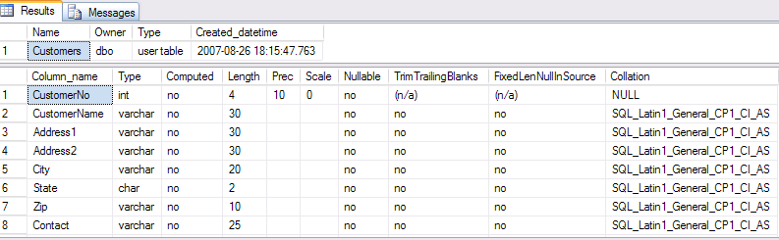
Verify Table
Once we create it, lets verify using a stored procedure:
EXEC sp_help Customers

Slide 33
The ALTER Statement
Is used to change a database object
Format is:
ALTER <object type><object name>

Slide 34
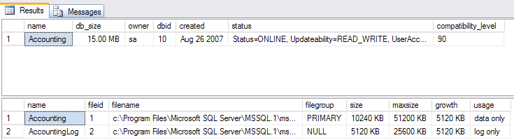
ALTER DATABASE
With Alter, you have to remember what you already have. Use EXEC sp_helpdb to look at a database structure.

Slide 35
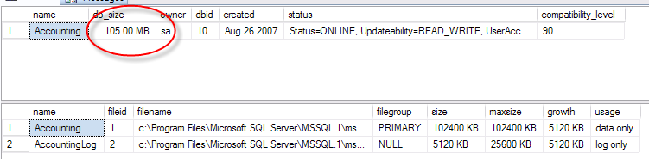
ALTER DATABASE Cont.
Lets say for example we need to increase the size of our database:
ALTER DATABASE Accounting
MODIFY FILE
(NAME = Accounting,
SIZE = 100MB)
EXEC sp_helpdb Accounting

Slide 36
ALTER TABLE
Alter table syntax has many options. *See book for full detail*
Example: Adding column(s) to a table:
ALTER TABLE Employees
ADD
PreviousEmployer varchar(30) NULL
ALTER TABLE Employees
ADD
DateOfBirth datetime NULL,
LastRaiseDate datetime NOT NULL DEFAULT '2005-01-01'

Slide 37
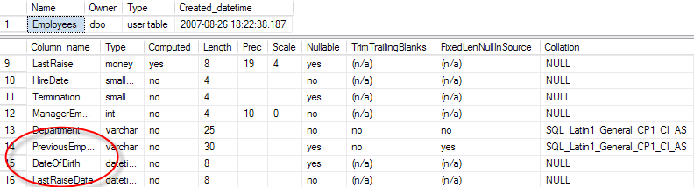
Verify Column Additions
EXEC sp_help Customers

Slide 38
DROP
Will delete tables
Be careful – no “Are you sure?” alerts!
To delete database:
USE Accounting
DROP TABLE Customers, Employees
USE master
DROP DATABASE Accounting

